Slide 1
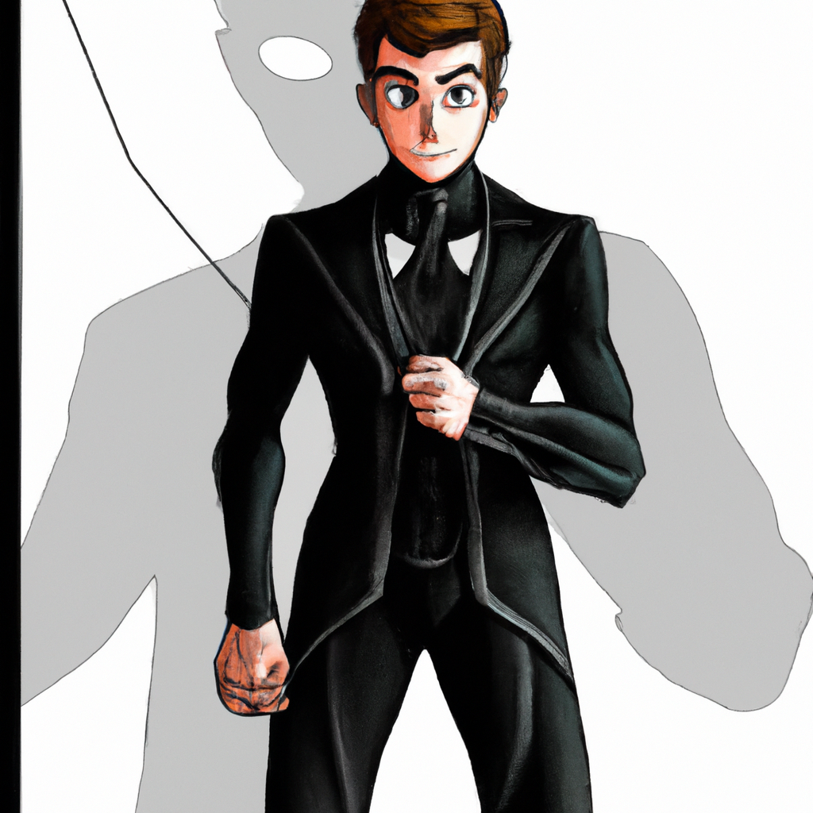
"Birth of the New Spider-Man: Legacy in Black"
Panel 1:
We see a hospital room where Peter Parker and his wife stand holding a newborn baby boy. Peter's eyes are filled with love and uncertainty.
Panel 2:
A few years later, the child, now a young boy, is shown climbing the walls of his bedroom, a look of pure joy on his face. Peter watches from the doorway, a proud but worried expression on his face.
Panel 3:
A montage sequence follows where Peter teaches his son about great power and great responsibility. They are shown in various settings; on top of a skyscraper, in a laboratory, in the middle of a web-slinging flight.
Panel 4:
The son, now a teenager, stands in front of a sewing machine with a determined look on his face. On the table next to him, a sketch of a black Spider-Man suit can be seen.
Panel 5:
With the suit completed, the son stands dramatically on a rooftop, the moon highlighting the sleek black suit. His face is hidden by the suit's mask, but his body language exudes a new-found confidence.
Panel 6:
The final panel shows the son, in his black suit, swinging through the city just like his father before him. But this is not Peter Parker's story any longer, it is now the tale of his son, the new Spider-Man.

Slide 2
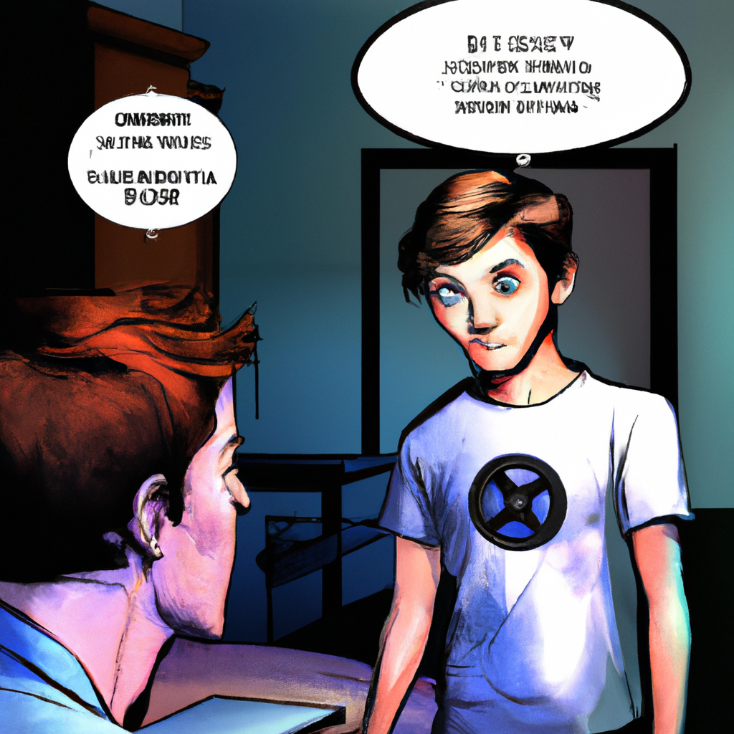
"Samuel Parker's Pizza Dinner Inquiry"
Panel 1: The scene starts with Samuel, Peter Parker's son, shown entering a brightly lit kitchen, his eyes wide with curiosity.
Panel 2: Samuel, with a questioning look on his face, asks, "What's for dinner?"
Panel 3: Mary Jane is shown, a warm smile on her face as she responds with, "We ordered pizza."
Panel 4: Samuel, looking satisfied and eager, simply replies, "Ok." The scene ends with the anticipation of a cozy family dinner.

Slide 3
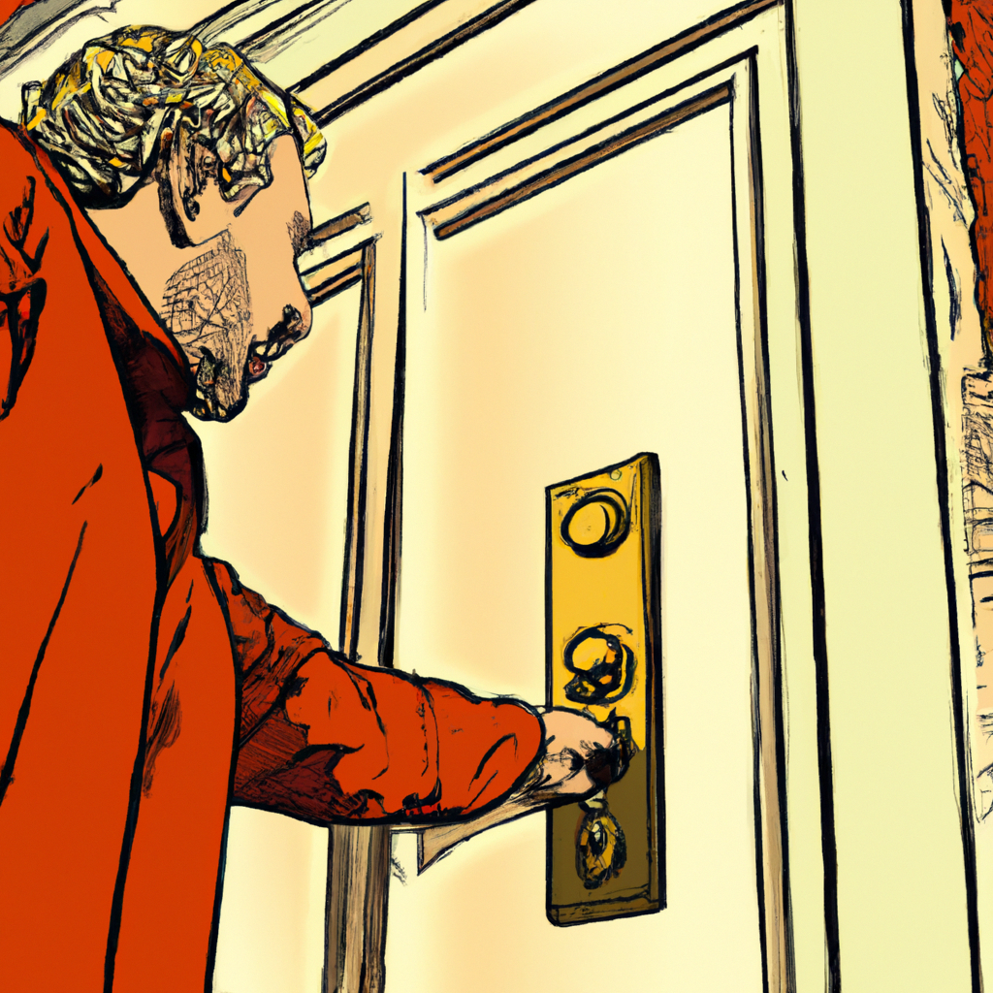
"Samuel's Invisible Visitor"
Panel 1: The quiet room is suddenly disturbed by the sound of a doorbell ringing - "Ding Dong!"
Panel 2: Samuel, who is sitting comfortably on the couch, looks up, surprised. "I'll get it," he declares, standing up from his comfortable position.
Panel 3: Samuel walks across the room, towards the door, his footsteps echo in the silent room.
Panel 4: Samuel reaches the door and opens it with a curious expression.
Panel 5: Samuel stands at the open door, looking out. His face now bears a look of confusion. There is no one to be seen. "But...No one's there..." he mutters to himself.

Slide 4
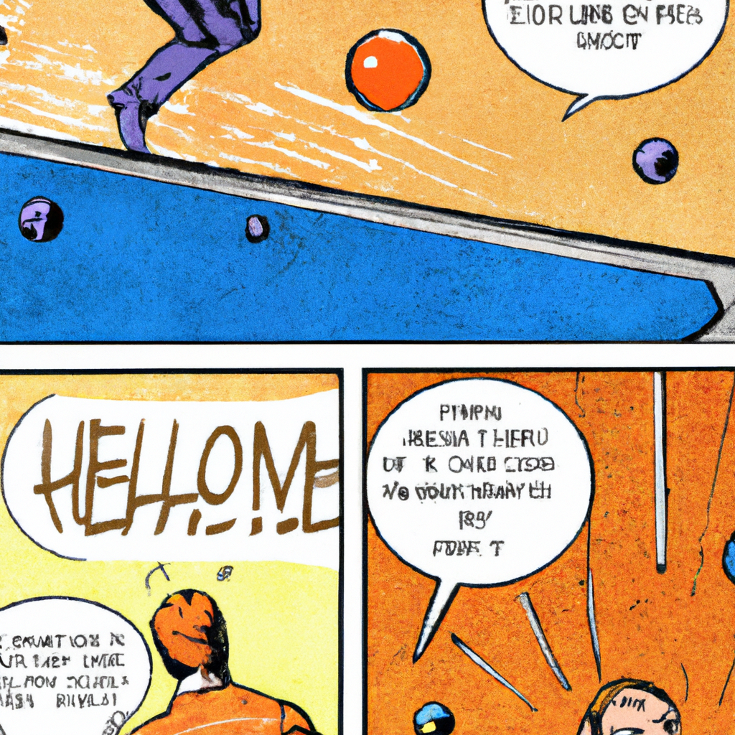
"Backflip to the Beeping Orange Ball"
First panel: A man stands alone, and with a cheerful smile on his face, he greets, "Hello," he said.
Second panel: Suddenly, an orange little ball tumbles from nowhere, hitting the ground with a soft thud. The ball starts to beep, creating an aura of suspense.
Third panel: Quick as a flash, the man performs a backflip. His body arcs beautifully in the air, a mixture of surprise and agility etched on his face.
Final panel: He lands perfectly on the kitchen bench, a triumphant look on his face as the beeping ball lies forgotten on the floor.

Slide 5
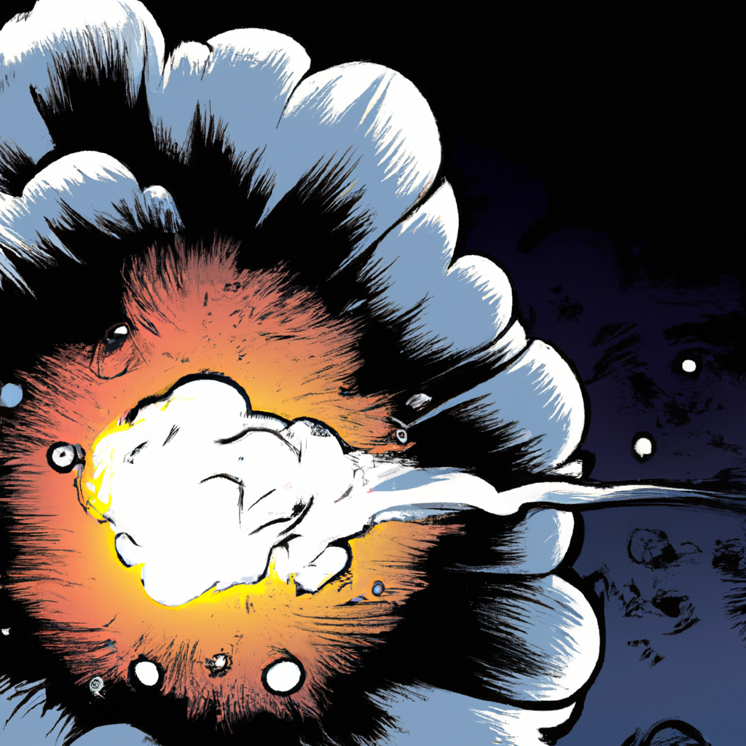
"Explosion_Shadow_Rising"
Panel 1: A quiet scene, perhaps a cityscape or a lonely desert. Suddenly, a loud BOOM echoes through the air.
Panel 2: A violent explosion erupts, lighting up the scene with fiery hues. Flaming debris flies in all directions, and the shockwave ripples through the surroundings.
Panel 3: Thick, heavy smoke billows out from the epicenter of the explosion, filling the air and obscuring the view.
Panel 4: As the smoke starts to clear slightly, an ominous shadow begins to take form. It's indistinct at first - a dark, vague shape against the smoky backdrop.
Panel 5: The shadow solidifies, emerging through the clearing smoke. It's an imposing figure, its identity still a mystery. The final panel leaves the reader in suspense, waiting to see who - or what - has come through the smoke.

Slide 6
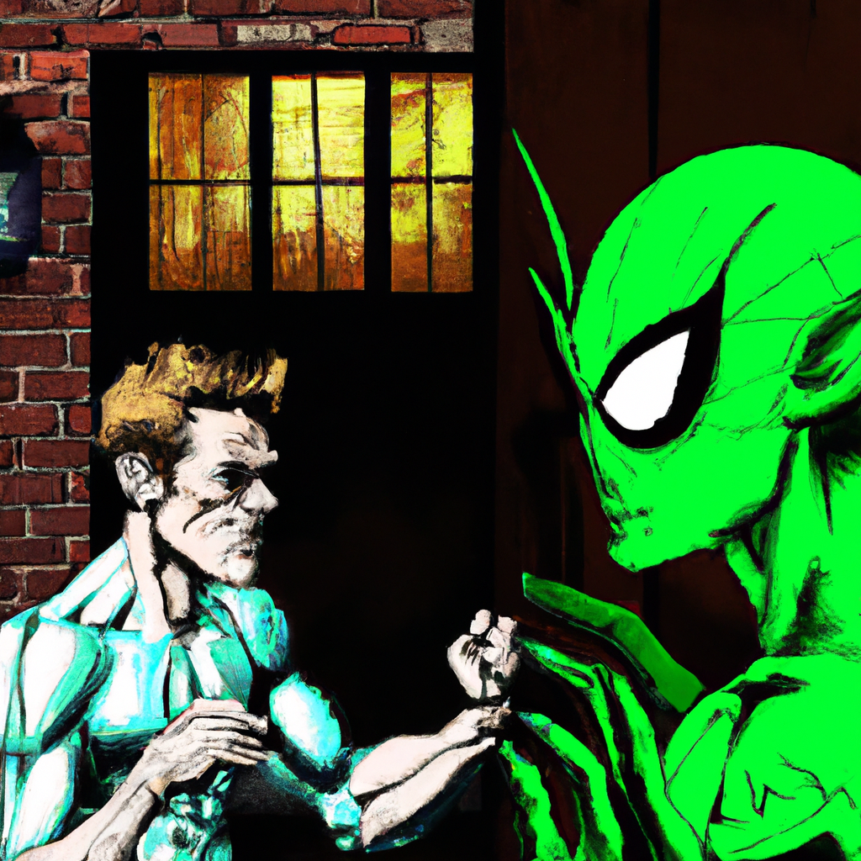
"Peter Parker's Unexpected Encounter with the Green Goblin"
Panel 1: The night is inky black. A shadow appears, ominously inching closer and closer to a house.
Panel 2: The shadow slips quietly through the door, casting a chilling silhouette against the dimly lit interior.
Panel 3: The shadow solidifies into a figure, revealing the menacing face of the Green Goblin.
Panel 4: He grins wickedly, his eyes fixed on an off-panel figure. The speech bubble next to him reads, "PETER PARKER! We meet again."
Panel 5: The audience is left in suspense, only imagining the impending confrontation.

Slide 7
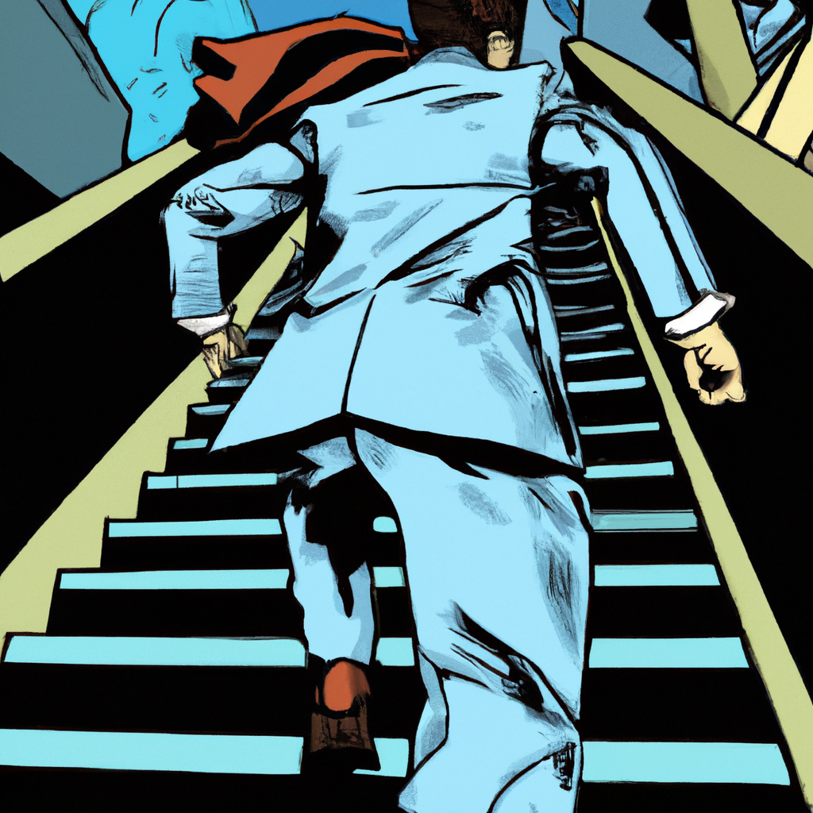
"Samuel's Dash for the Suit"
Panel 1: Wide shot of a house, Samuel is seen at the bottom of the stairs, adding motion lines to show urgency in his movement.
Narrator text: "In a sudden rush, Samuel dashes towards the stairs."
Panel 2: A mid-shot, focusing on Samuel who is now halfway up the stairs. Sweat is dropping from his forehead, his face showing a determined expression.
Narrator text: "He bolts halfway upstairs, his determination evident on his face."
Panel 3: Close-up shot of Samuel's hand, as it grabs the doorknob of his room.
Narrator text: "His hand tightly grips the doorknob, turning it quickly."
Panel 4: Inside Samuel's room, we see an open closet. Samuel is reaching for his suit hanging inside.
Narrator text: "His suit, hanging neatly in the closet, is quickly seized by Samuel."
Panel 5: Back to Samuel, now holding his suit. He is seen panting, sweat still visible on his forehead.
Narrator text: "Suit in his grasp, Samuel pauses, panting heavily from his quick actions."

Slide 8
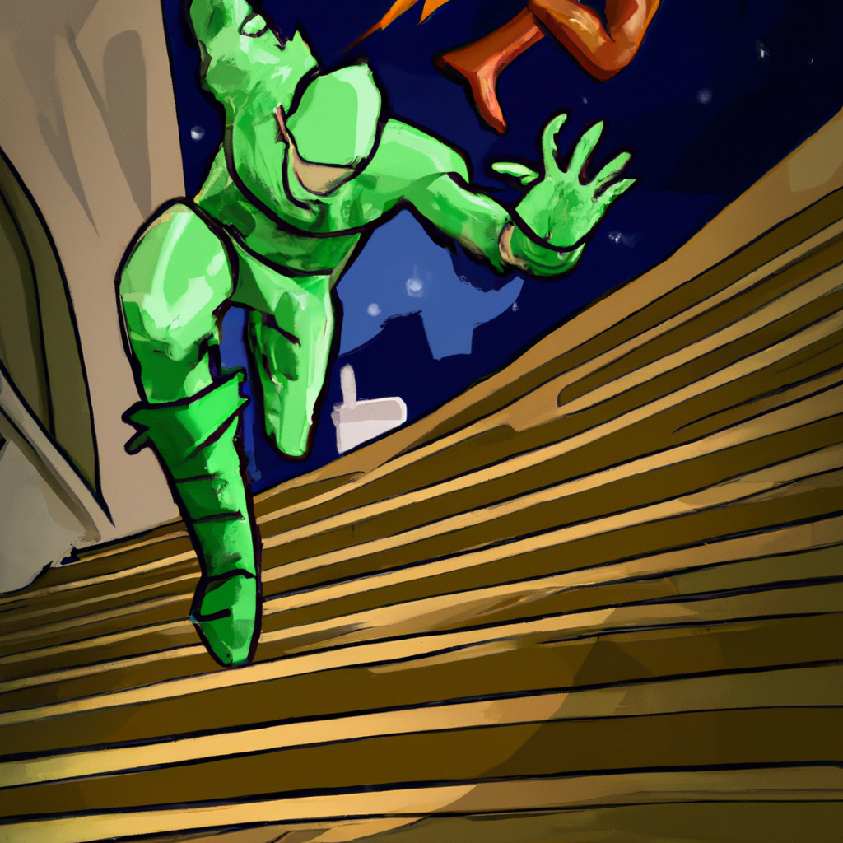
"Downward Dash and Goblin Clash"
Panel 1: A sketched silhouette of a man is seen running energetically down a flight of stairs. Action lines emphasize his speed.
Panel 2: We get a close-up of the man's determined face; his eyes are locked onto a target not yet shown to us.
Panel 3: We switch to the view of the Green Goblin, a villainous figure, caught surprised and off-guard. His eyes widen as he spots the man running towards him.
Panel 4: The man lunges at the Green Goblin, a clenched fist swinging through the air.
Panel 5: The Green Goblin is hit squarely in the face, his body recoiling with the force of the punch. Small stars or birds might be seen around his head to emphasize the impact.
Panel 6: The man stands victorious, panting heavily, as the Green Goblin lies defeated on the ground. His posture and expression convey a mix of satisfaction and exhaustion.

Slide 9
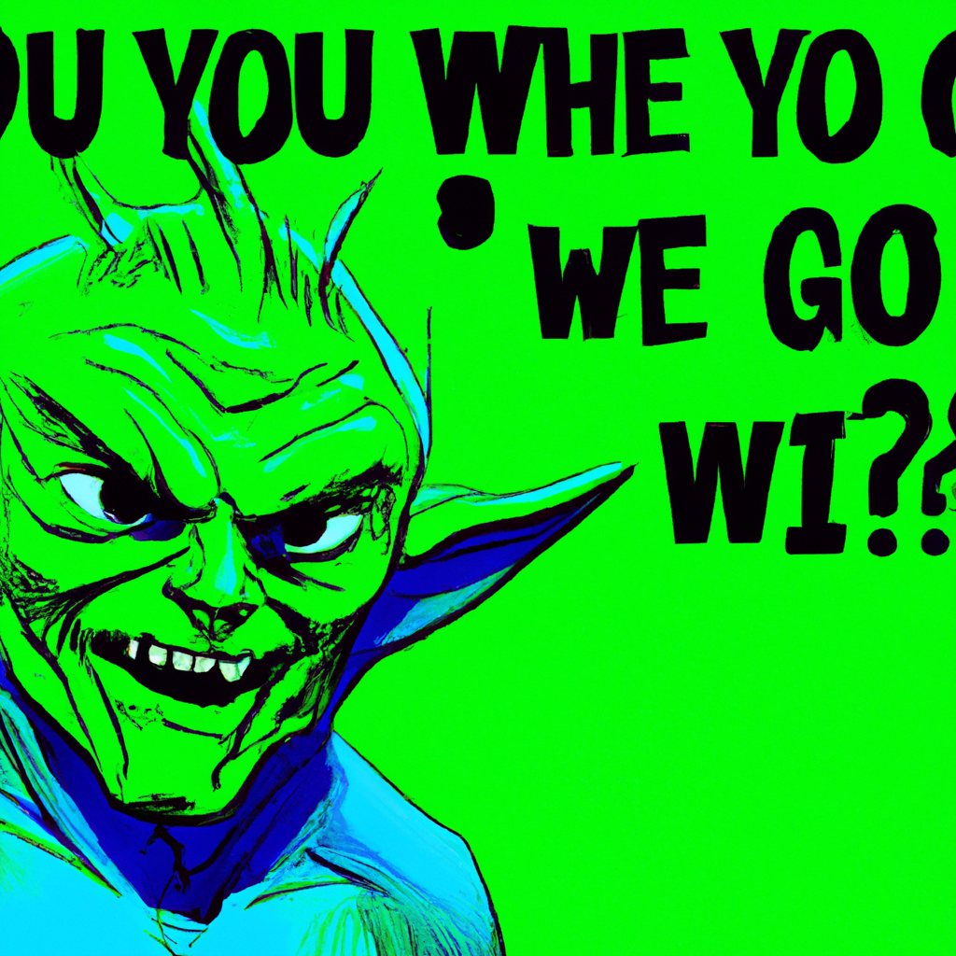
"Unexpected Encounter: Green Goblin's Question"
Panel 1: The scene opens with the Green Goblin, a grotesque figure with a menacing grin, leering at an off-panel character. His question, "Oh, and who are you?" is written in a speech bubble above him.
Panel 2: The viewpoint switches to the off-panel character's perspective. No response is given yet, creating a suspenseful pause.
Panel 3: The off-panel character steps into the frame, revealing their identity. Their response, if any, would be written in their speech bubble.
(Note: This is a description of a general layout. The identity of the off-panel character is kept vague due to lack of specified context.)

Slide 10
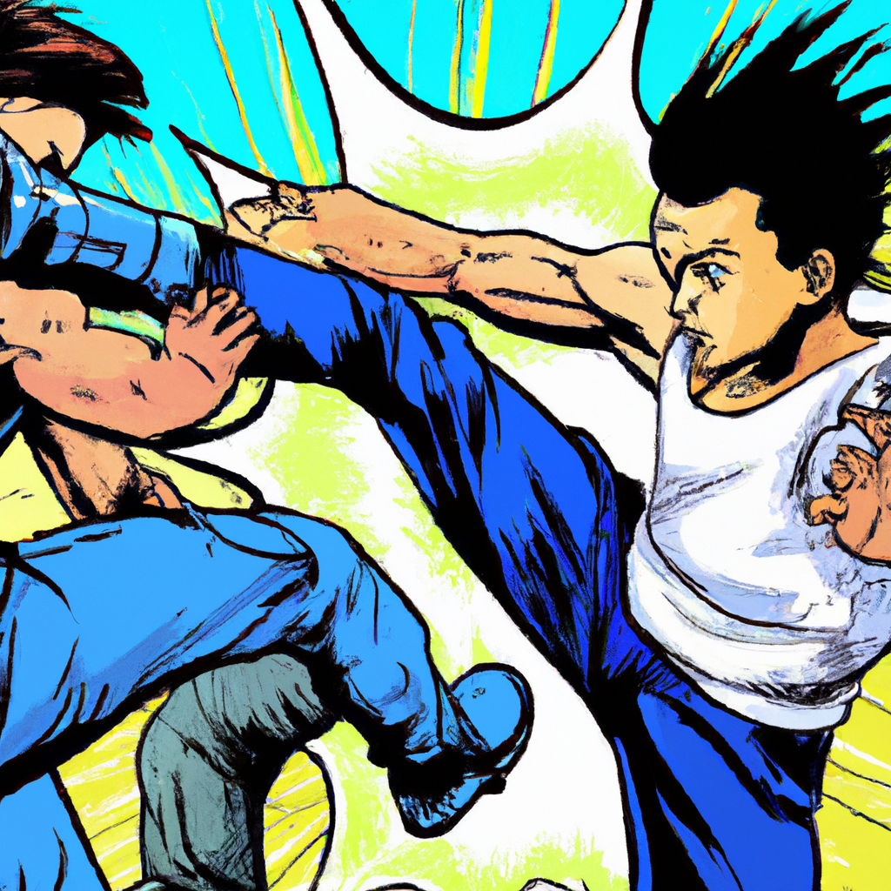
"Samuel's Double Kick and Punch"
Panel 1:
Samuel is poised, tensed for action, his eyes determined and focused on his opponent.
Panel 2:
With a swift motion, he draws his leg back and launches it forward. The force of the kick sends his opponent staggering back.
Panel 3:
Without waiting, Samuel repeats the action, delivering a second, equally powerful kick. The opponent looks visibly shaken.
Panel 4:
Samuel finishes his assault with a punch, his fist connecting solidly with his opponent's face. The final hit is enough to knock his opponent off his feet.

Slide 11
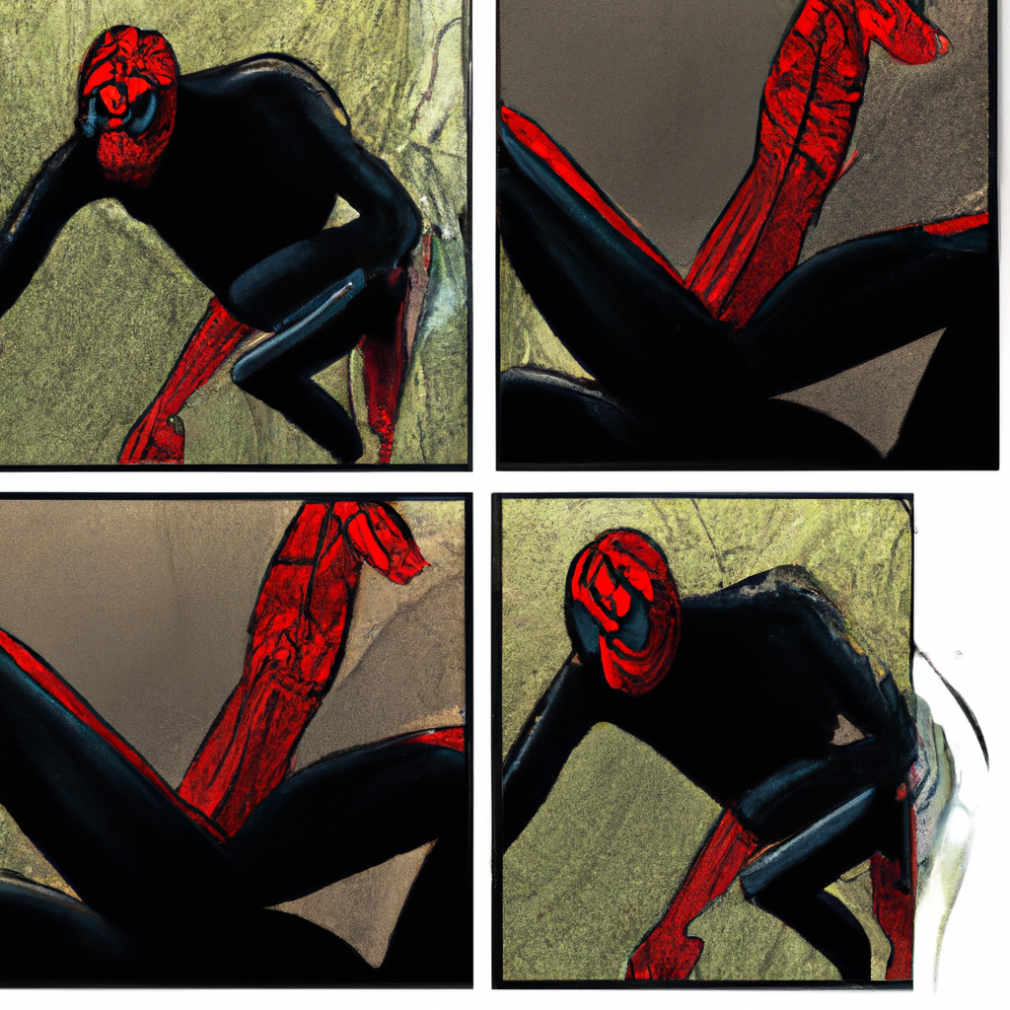
"Samuel's Double Web Shot as the Black Spider-Man"
Panel 1: Samuel is seen in a dynamic pose, hands outstretched. From his palms, two thick webs jet out, speeding towards the off-panel target.
Panel 2: Close-up on Samuel's masked face, a fierce determination in his eyes as the webs shoot out.
Panel 3: The webs connect with their target off-panel, the impact illustrated by a stark "THWACK!" sound effect in bold lettering.
Panel 4: Samuel, now in a relaxed position, looks off-panel towards his target. He says with a smirk, "Black spider-man."

Slide 12
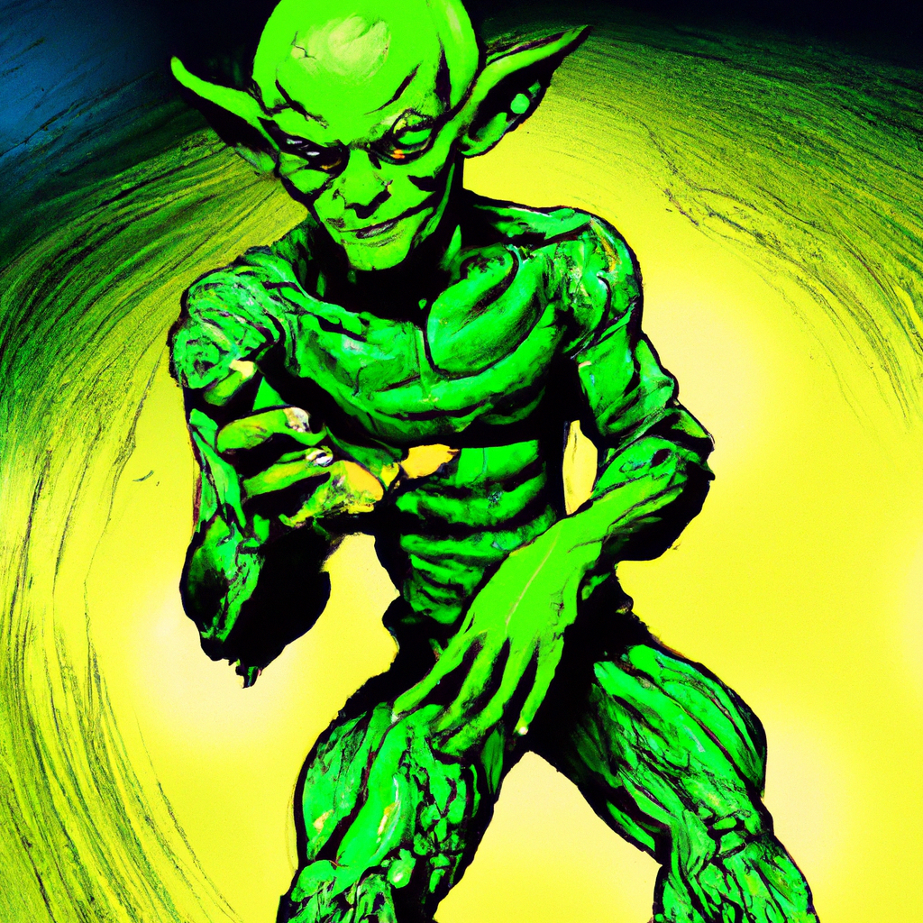
"Unexpected Encounter: Green Goblin Rises"
Panel 1: The scene opens with the Green Goblin lying horizontally on the ground. He slowly begins to push himself up.
Panel 2: The Green Goblin is now standing, dusting off his green suit. He looks straight ahead, a surprising calm in his eyes.
Panel 3: Cut to the view from Green Goblin's perspective. He sees a shadowy figure which is not shown to the viewer, the figure seems to be someone he doesn't recognize.
Panel 4: Close up of Green Goblin's face. He smiles and speaks, "Oh, I haven't met you," he said.
Panel 5: Green Goblin pulls back his shoulders, stands tall and proud. His smile turns into a smirk, excitement twinkling in his eyes.
Panel 6: The scene ends with the Green Goblin introducing himself, "I am..." His words hang in the air, leaving a sense of suspense.

Slide 13
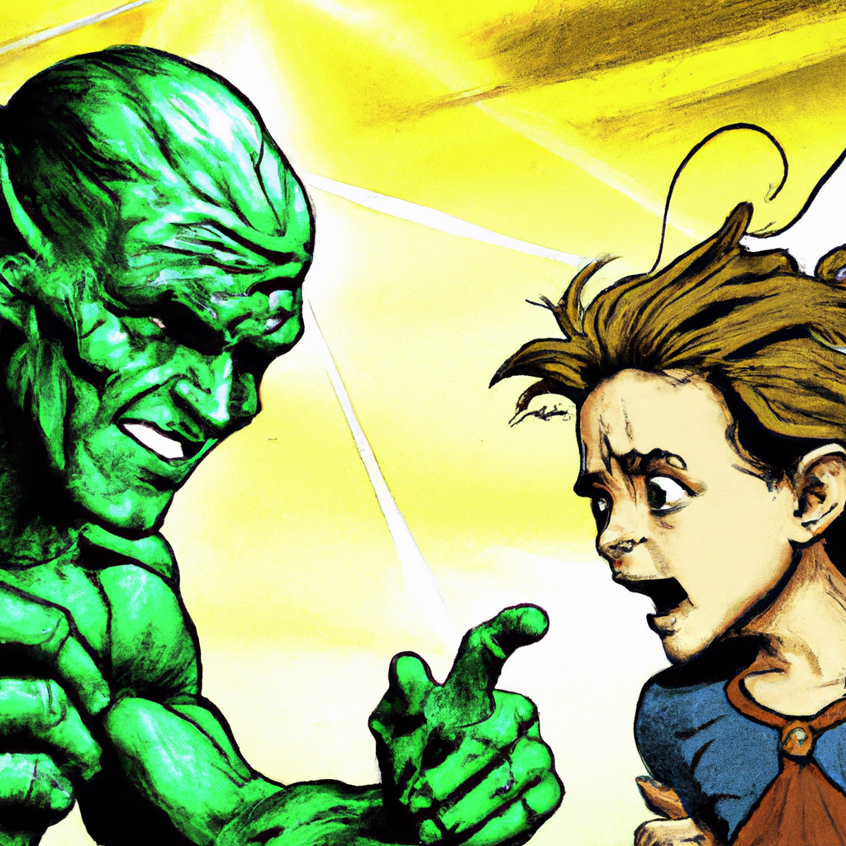
"Samuel Confronts Green Goblin"
Panel 1: A medium shot of Samuel, his face stern and focused. He stands tall and resolute, as though he's been preparing for this confrontation for a long time. He says, "I know who you are...".
Panel 2: The text "Green Goblin" is written in bold, echoing from Samuel's voice as his words hang in the air. The background is a contrast of light and dark, emphasizing the tension of the moment.
Panel 3: Green Goblin is revealed, his face masked with a sinister grin. He seems taken aback by the accusation, yet there’s a glint in his eye indicating amusement, maybe even a hint of respect.
Panel 4: Close up of Samuel's face. His determination is palpable. He's not backing down. He interrupts any response from Green Goblin with a resolute, "Silence, I have the upper hand here." His eyes reflect a mixture of courage and defiance.
Panel 5: The last panel captures the silent standoff between these two characters, Samuel standing strong against the dangerous Green Goblin. The stage is set for the confrontation ahead.

Slide 14
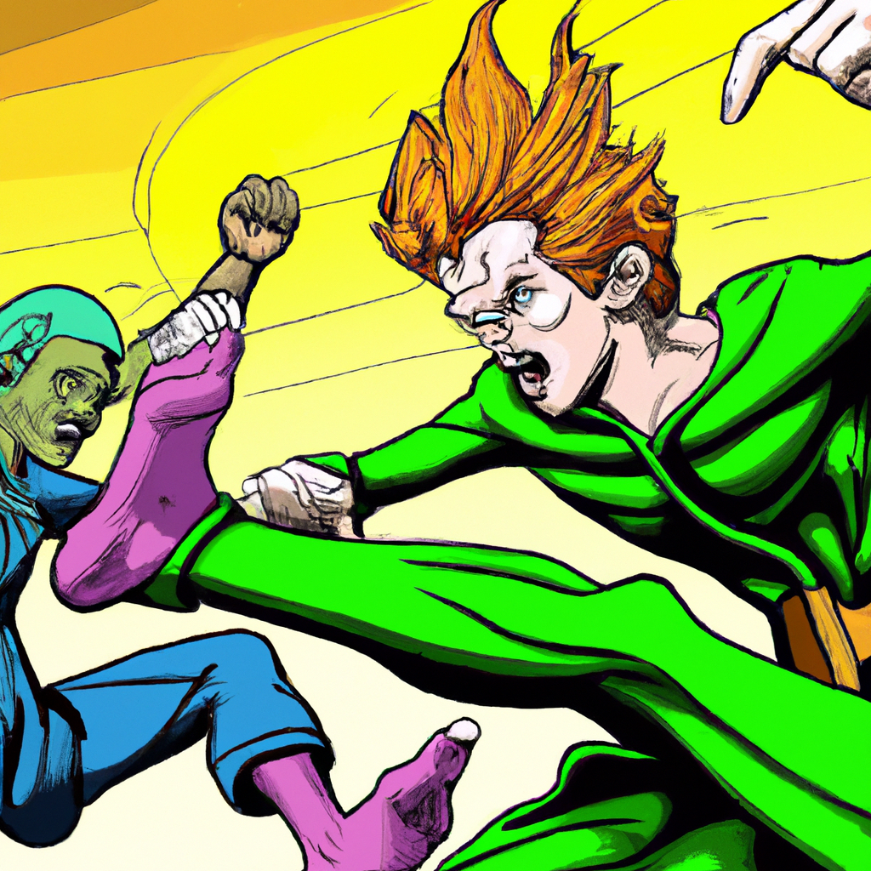
"Samuel's Foiled Kick Against Green Goblin"
Panel 1: Samuel is seen winding up for a powerful kick, a determined look on his face, with the backdrop of the city behind him.
Panel 2: The Green Goblin, agile and sneering, anticipates the move. His eyes are focused, and his arm raises in preparation to block the incoming attack.
Panel 3: The moment of impact. Samuel's foot meets the Green Goblin's block, the force of it creating a visible shockwave that distorts the air around them.
Panel 4: A close-up on Samuel's surprised face as he realizes his kick was blocked, sweat sprouting on his forehead.
Panel 5: The Green Goblin, grinning maliciously, successfully blocks Samuel's kick, throwing Samuel off balance.
Panel 6: Samuel is seen staggering backward, the look of surprise still on his face. The Green Goblin stands triumphant, ready for the next move.

Slide 15
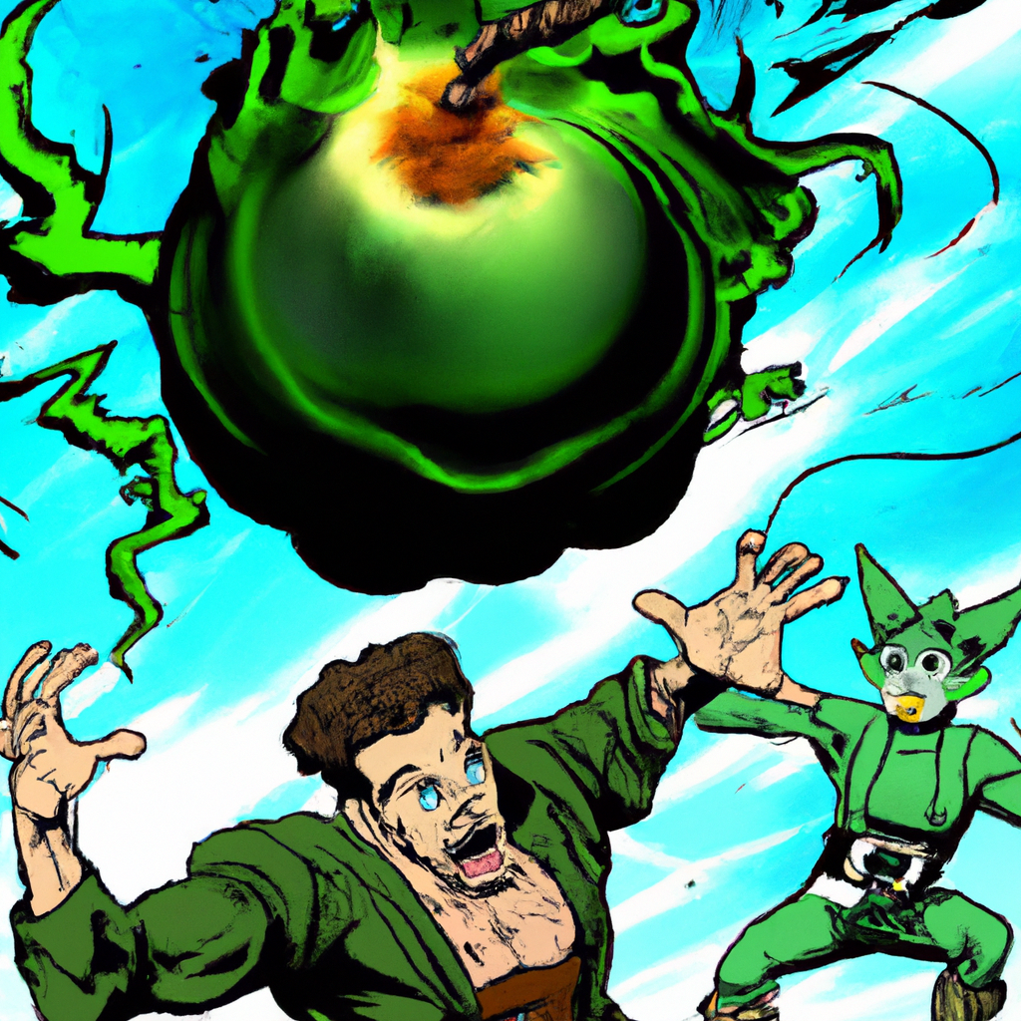
"Samuel's Counterattack on Green Goblin"
Panel 1:
Green Goblin, a villain with a maniacal grin and green, scaly costume, his glider's smoky trail curling behind him, latches onto Samuel's leg.
Panel 2:
As the cityscape blurs around them, Samuel's face, cast in alternating patches of light and shadow, is filled with a mixture of fear and determination. He's swung around in wild, unpredictable arcs.
Panel 3:
Samuel reaches into his belt with his free hand, his fingers closing around a small, round object.
Panel 4:
With a gritted-teeth war cry, Samuel hurls the object towards the Green Goblin. It's a bomb, its fuse now lit and leaving a bright trail as it speeds towards its target.
Panel 5:
Green Goblin's grin fades as he spots the incoming bomber, releasing Samuel and trying to veer his glider away in a desperate attempt to avoid the explosion.

Slide 16
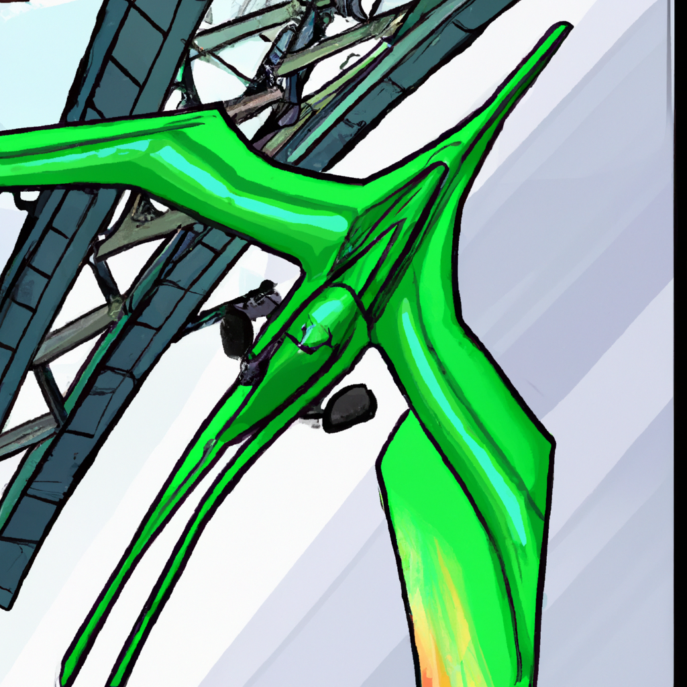
"Green Goblin's Tower Glider Attack"
1. Frame One: The setting is a towering skyscraper stretching high into the sky, almost touching the clouds. The cityscape sprawls in the background.
2. Frame Two: A sudden flash of green breaks the monotony of the grey sky. An ominous figure perched on a jet-powered glider reveals itself, casting a chilling silhouette against the cold city skyline. This is the Green Goblin.
3. Frame Three: The glider swoops down, with the Green Goblin cackling maniacally. His menacing figure now fully visible, he's decked out in his signature green and purple outfit, a terrifying grin plastered on his grotesque mask.
4. Frame Four: The glider races towards the ground at breakneck speed, the wind whooshing past the Green Goblin, his laughter echoing in the silent cityscape.
5. Frame Five: The Green Goblin, now closer to the ground, stretches out his hand, preparing to unleash havoc on the city below. The frame ends with the glider just about to disappear from view, emphasizing the speed at which it's descending.

Slide 17
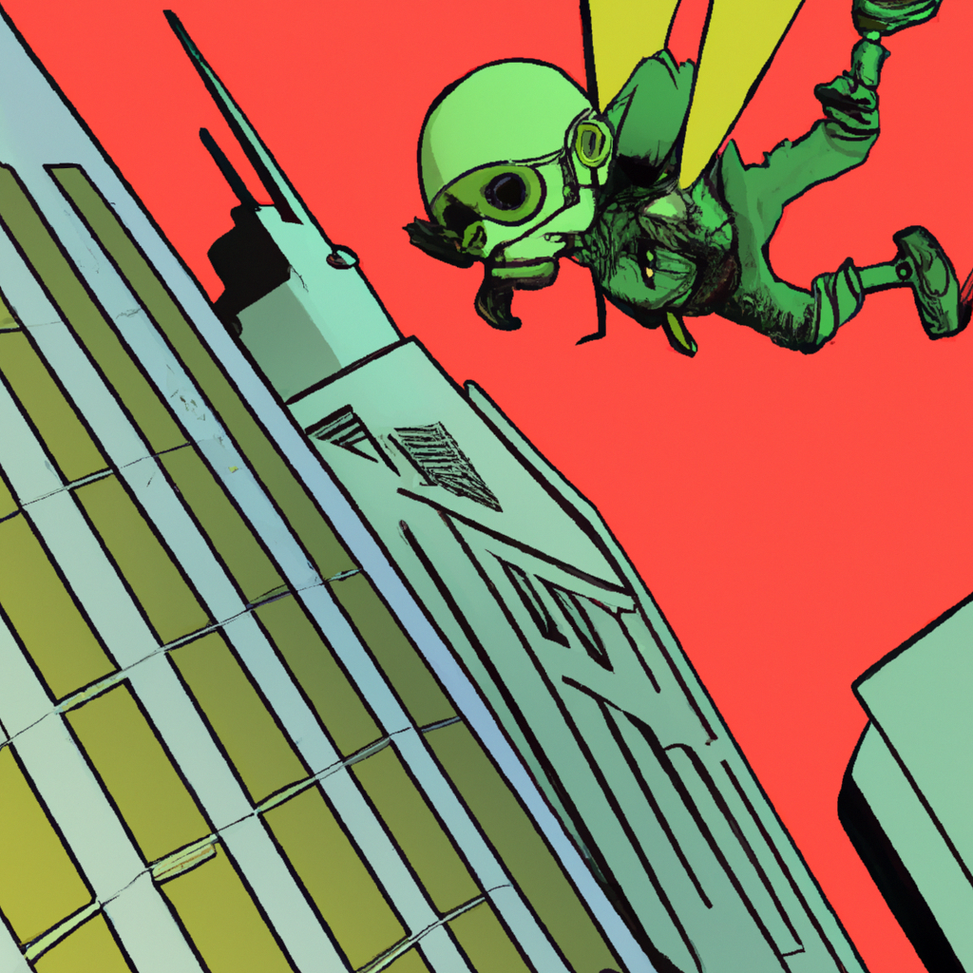
"Green Goblin's Swift Glider Jump"
Panel 1: The Green Goblin stands tall, his menacing figure cloaked in shadow. His glider, a sleek metallic beast, hovers nearby.
Panel 2: With a swift, agile motion that belies his wickedness, the Goblin jumps, his feet landing firmly on his glider.
Panel 3: As the glider rockets off into the night, the Goblin cackles, the sound echoing into the darkness.
Panel 4: The destination comes into view - a towering building, ominous and foreboding. The building from which the glider came.
Panel 5: The Green Goblin, atop his glider, approaches the building, the city lights reflecting off its high glass windows. His malevolent grin creating an eerie contrast to the quiet cityscape.
The End.

Slide 18
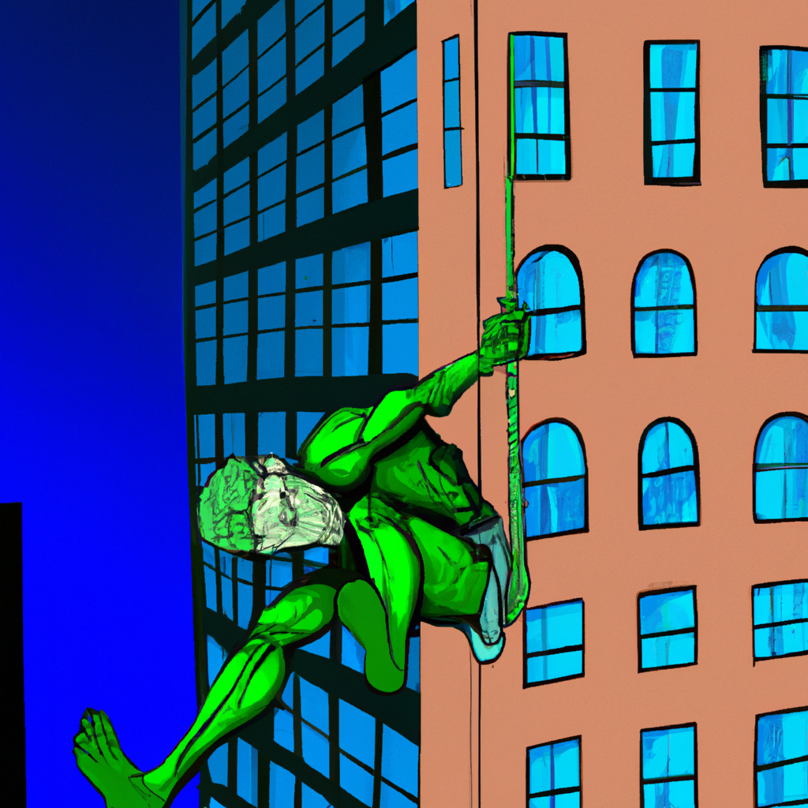
"Samuel's Pursuit of the Green Goblin"
Frame 1: We see Samuel, face twisted in frustration, shouting "DAMMIT!" His voice echoed through the surrounding area, giving an intense vibration to the scene. The dialogue box at the bottom reads Samuel's exclaiming word.
Frame 2: The next scene zooms out to reveal Samuel's full figure, his body already in motion. He stretches his arm out, launching himself upwards towards the towering building.
Frame 3: The focus switches to the building that the Green Goblin had taken refuge on. Green Goblin's sinister figure is seen from a distance, perched atop the building, looking down on Samuel. The looming silhouette of the building and the Goblin give a sense of impending confrontation.
Frame 4: Samuel swings towards the building, his figure a blur against the backdrop of the cityscape. The Green Goblin's figure is seen getting closer as Samuel approaches. The motion lines emphasize Samuel's speed and determination, amplified by the trailing dialogue box which reiterates his previous exclamation, signifying his unyielding pursuit.

Slide 19
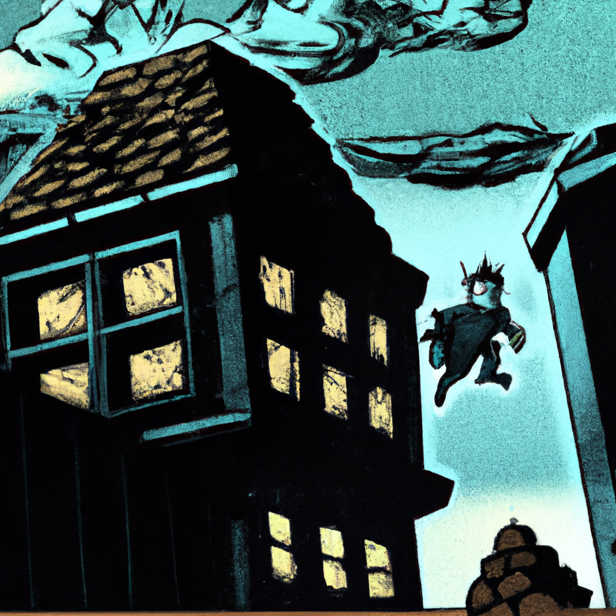
"Samuel's Midnight Landing: Goblin's Hideout"
Panel 1: The first square showcases Samuel, mid-jump, soaring through the air towards an ominous-looking building. His determined expression is contrasted against the dark backdrop, the city lights twinkling in the distance.
Panel 2: The focus shifts to the building Samuel's heading towards. There's an eerie silence, the tall, imposing structure is shadowed with a sinister aura, hinting that the Goblin has made it his lair.
Panel 3: Samuel lands with a soft thud on the building's roof, his eyes narrowed, scanning the area. His silhouette is stark against the moonlit sky, adding to the suspense.
Panel 4: Submerged in complete darkness, Samuel's sight is compromised. He squints, trying to adjust his vision to the encroaching darkness. All around him, the world seems to have slipped into an abyss of black.
Panel 5: Samuel, refusing to back down, clenching his fists, fully aware of the danger lurking around. The panel ends with a close-up of his resolute eyes, glinting with an unyielding spirit, as he steps into the unknown.

Slide 20
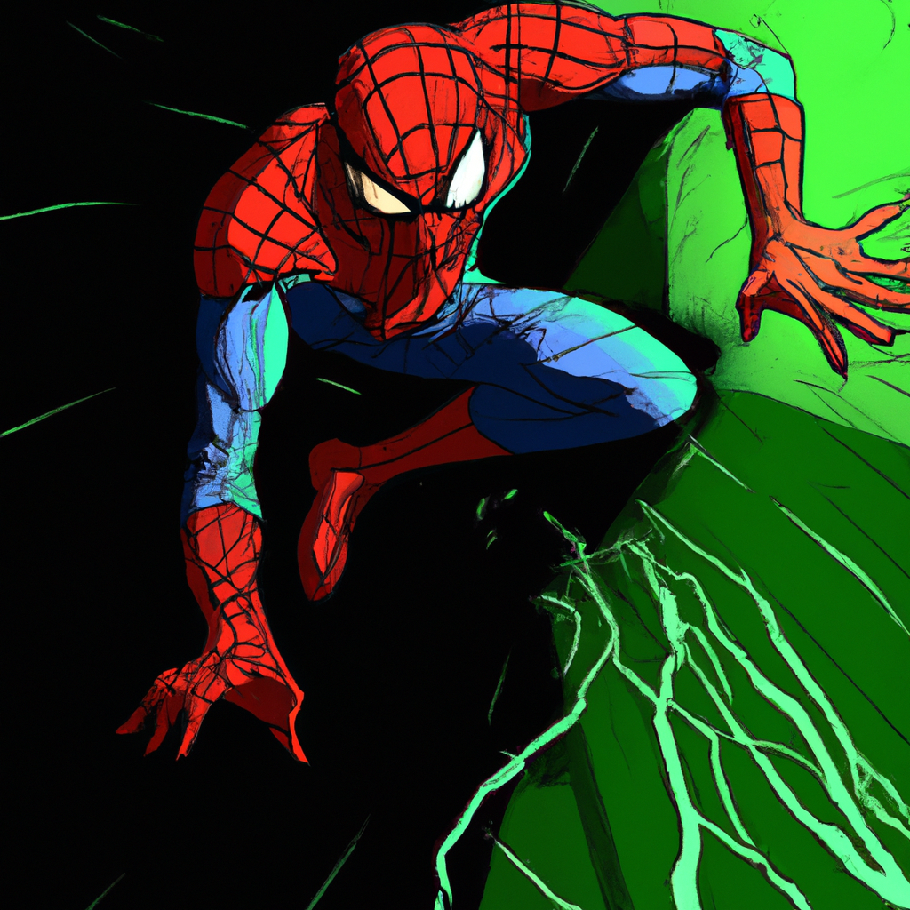
"Spidey Sense Tingling: The Green Goblin Emerges"
1. In the first panel, we see our hero, a man in a vibrant red and blue suit. His eyes, large white ovals behind the mask, squint subtly. The words 'Spidey sense tingling!' are written in a thought bubble next to his head.
2. The next panel zooms in on Spider-Man's eye, reflected in it is a figure emerging from the shadows.
3. The third panel is a split screen. On one side, Spidey's eyes widen in surprise and fear. On the other side, a grinning, menacing face is revealed, its skin an eerie green, a twisted smile showing sharp white teeth - the Green Goblin.
4. The final panel shows the Green Goblin menacingly stepping out from the shadows, his silhouette casting a long, ominous shadow behind him. Spider-Man is seen in the foreground, poised and ready for action.

Slide 21
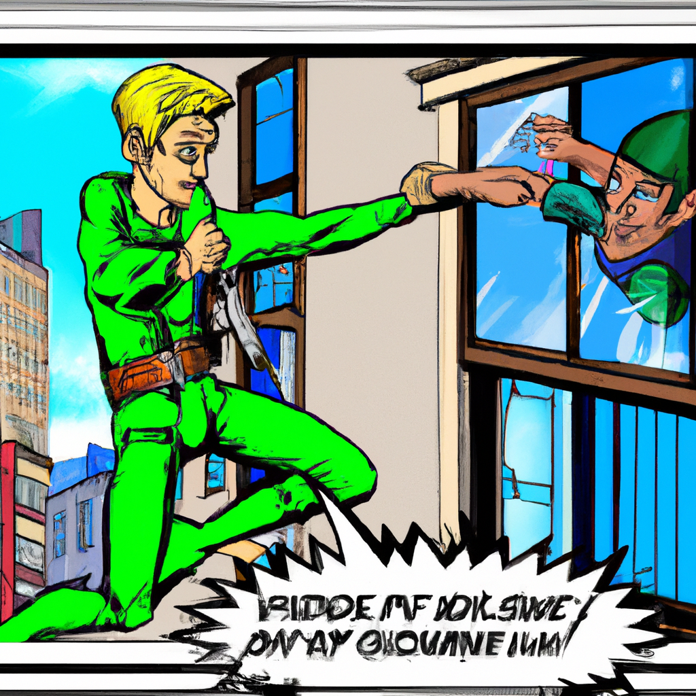
"Samuel's Epic Confrontation with the Green Goblin"
First Panel: Samuel stands facing away from us, his body tensed in readiness. His eyes are sharply focused on the creepy figure of the Green Goblin who is sneering at him.
Second Panel: With a swift, powerful spin, Samuel's fist connects with the Green Goblin's face. There's a loud 'WHAM!' sound effect overlaid.
Third Panel: The Green Goblin is sent reeling through the air, his face a picture of shock and surprise as he sails out the window. The city scenery blurs behind him emphasizing his speed.
Final Panel: The Green Goblin lands with a comical 'SPLAT!' in the middle of the police station. Police officers look on in surprise as the defeated villain groans from the impact.

Slide 22
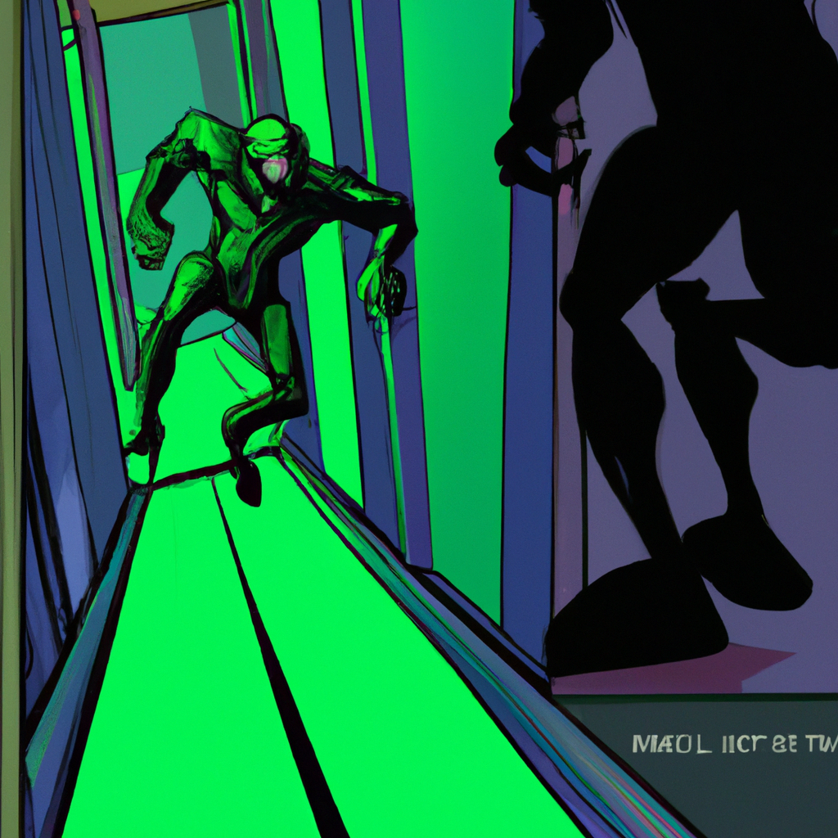
"Green Goblin's Escape: The Police Chase"
Panel 1: Full shot of the Green Goblin, a malicious grin on his face as he pushes off the ground and slowly rises, dust spiraling around as he stands in a dimly lit room.
Panel 2: Close-up on his piercing eyes, glowing dangerously, the reflection of his wicked plans dancing in his gaze.
Panel 3: Quick cut to an office hallway, police officers with drawn guns, fear and determination etched on their faces as they burst into a run.
Panel 4: The sound of hurried footsteps and heavy breathing echo in the long, barren corridor, wanted posters and office doors a blur as they dash past.
Panel 5: A distant view of the hallway from the Green Goblin's perspective, the police officers appearing as tiny figures, their hurried footsteps growing louder.
Panel 6: Close-up of the Green Goblin's face again, his grin growing wider as he anticipates the imminent confrontation.

Slide 23
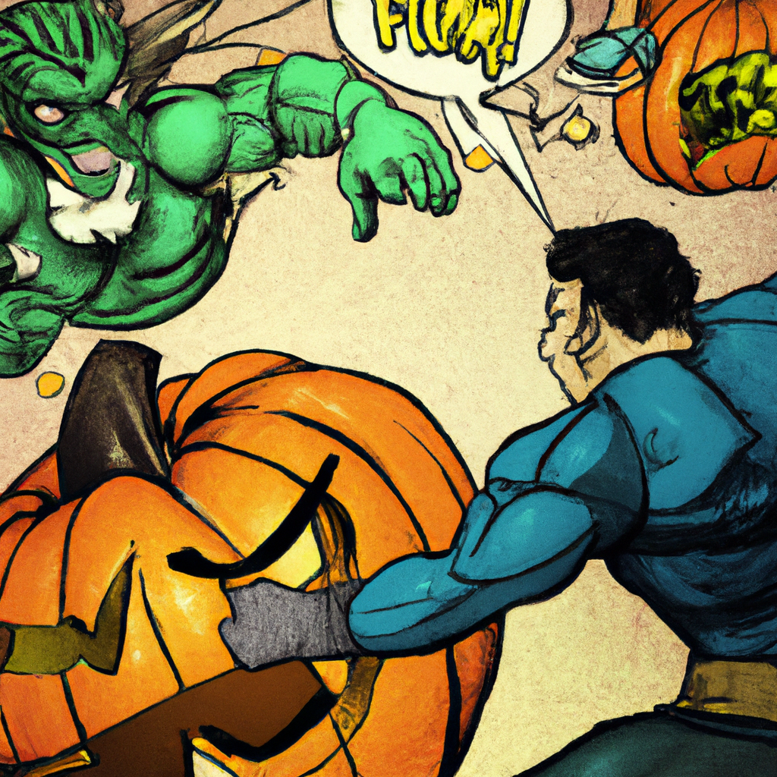
"Green Goblin's Rampage: Chaos in the City"
First Panel: The Green Goblin stands tall and menacing, his muscles tense and his lips pulled into a wicked smirk. He's clutching a frightened police officer by the collar. Other officers stand in the background, their faces filled with fear and determination.
Second Panel: With a swift and powerful motion, the Green Goblin punches the officer in his grasp. The officer's face contorts in pain and surprise as he's sent flying backwards.
Third Panel: The Green Goblin reaches into his bag, pulling out a sinister, grinning pumpkin. The pumpkin glows with an eerie light, casting long, dancing shadows.
Fourth Panel: The Green Goblin, with a hearty laugh, hurls the pumpkin towards the remaining officers. They scatter in panic, their faces a mixture of horror and disbelief.
Final Panel: The pumpkin explodes mid-air, illuminating the scene with its wicked, orange light. The officers are thrown in every direction, their screams lost in the chaos. The Green Goblin stands in the center of it all, laughing maniacally.

Slide 24
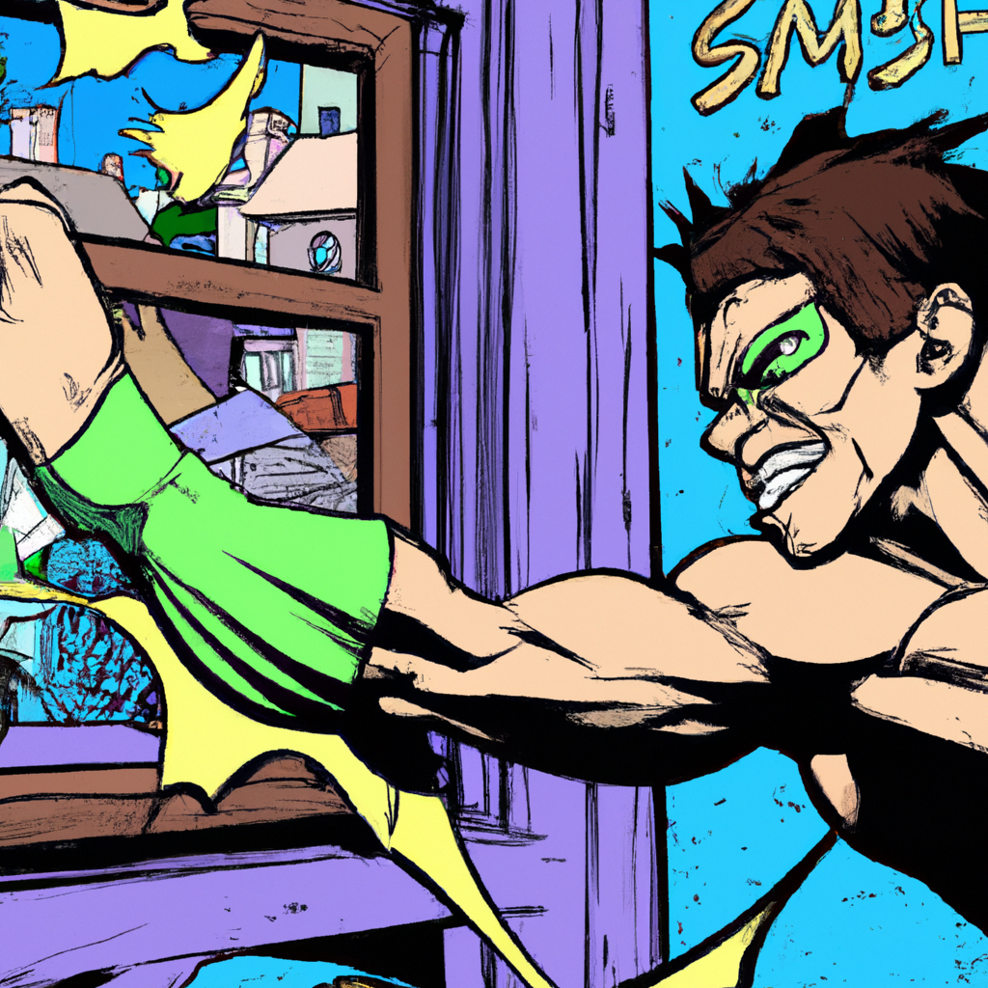
"Samuel's Smashing Encounter with the Green Goblin"
Panel 1: Close-up of Samuel's face. His eyes are determined, focused. He's about to make a move.
Panel 2: Wide shot. Samuel runs towards a closed window. Glass shards explode outward as he hurls himself through.
Panel 3: Mid-shot. Samuel's silhouette against the backdrop of the shattered window. He's in mid-air, fist drawn back.
Panel 4: Close-up of the Green Goblin's face. It shows surprise, unaware of Samuel's attack.
Panel 5: The impact. Samuel's fist connects with the Green Goblin's face. The Goblin is thrown backwards by the force.
Panel 6: Wide shot. The Green Goblin crumples to the ground, defeated. Samuel stands victorious among the shards of glass.

Slide 25
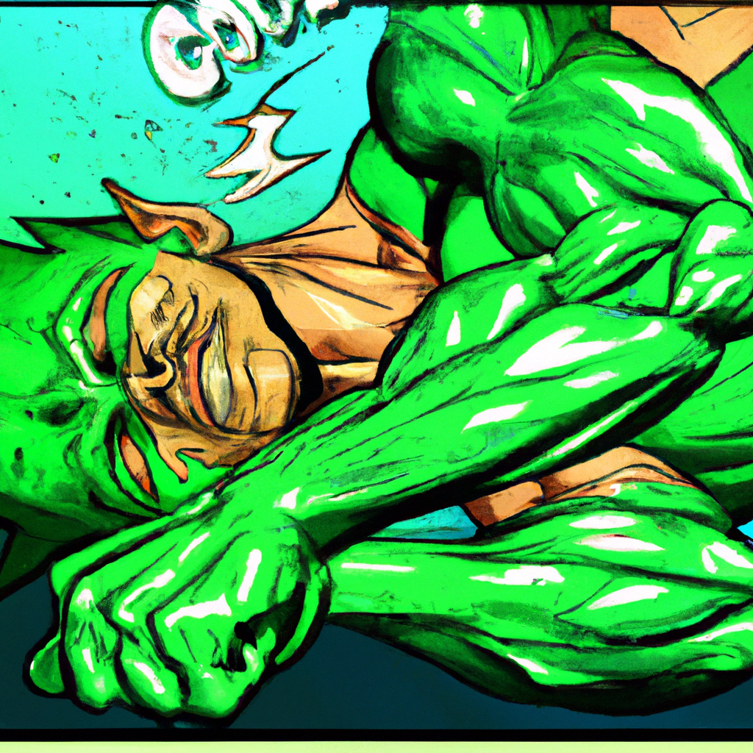
"Green Goblin's Downfall"
Panel 1: A wide shot of the New York City skyline at night, with the moon casting a cool glow over the tall buildings.
Panel 2: Closer shot of two silhouettes battling fiercely atop a skyscraper, recognizable as Spider-Man and the Green Goblin.
Panel 3: Spider-Man delivers a powerful punch, connecting squarely with the Green Goblin's jaw. The impact lines around his fist suggest great force.
Panel 4: The Green Goblin is shown flying backwards from the force of the punch. His eyes are closed and his body is limp, clearly knocked unconscious.
Panel 5: The Green Goblin lands on the ground, slumped over and unmoving. Spider-Man is seen standing in the background, fists clenched and standing tall.
Panel 6: Close up of Spider-Man's face, he's looking down at the fallen Green Goblin, his eyes displaying a mix of relief and concern. The city skyline is reflected in the lenses of his mask.
Panel 7: Final panel is a distant shot of the rooftop, Spider-Man is seen standing alone with the unconscious Green Goblin at his feet. The city lights twinkle below, peaceful and unaware of the battle that just took place above them.

Slide 26
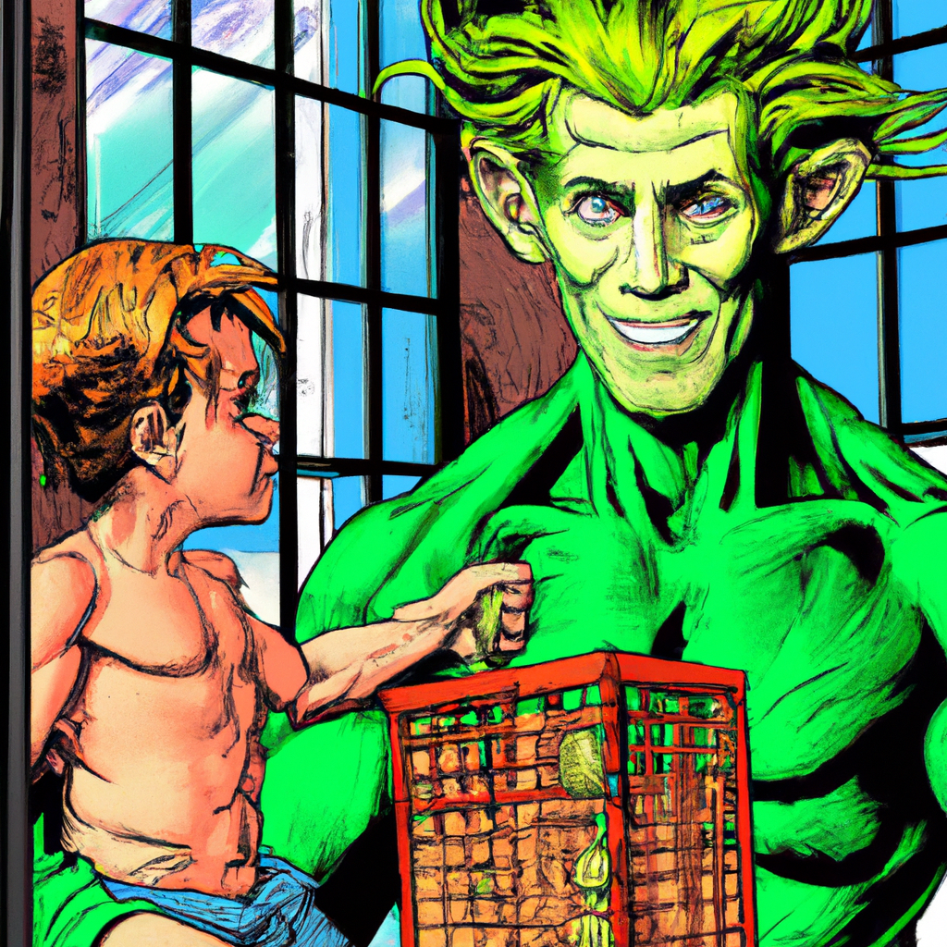
"Samuel and the Captured Green Goblin"
Panel 1: Drawn in bold lines, we see Samuel, a burly figure with a determined look on his face. He's reaching out towards the green goblin, his fingers almost touching the creature.
Panel 2: Close up on Samuel's hand as it wraps around the goblin. The goblin, small and green, looks shocked and scared. Samuel's grip is firm.
Panel 3: Samuel takes the goblin's stuff - a bag of gold coins, a rusty dagger, and an old map, all drawn in meticulous detail.
Panel 4: Samuel, with the goblin tucked under one arm, opens a heavy, iron-barred door. The door creaks loudly - you can almost hear it.
Panel 5: Samuel throws the goblin into the cell. The goblin lands with a "thud", looking startled and scared.
Panel 6: The cell door slams shut, the sound echoing in the silence. Samuel walks away, the image of him growing smaller with each step.
Each panel is filled with dramatic tension and action, capturing the event in a way that's both fascinating and engaging.

